Slide 1
Predicting probable flood drivers based on historic record and watershed characteristics.
Initial Proposal/ Outline
Heather McGrath, PhD.
Oct 28. 2024
All figures/data are preliminary, for discussion and subject to change

Slide 2
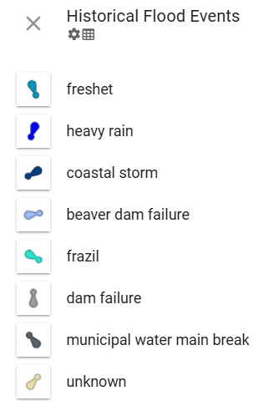
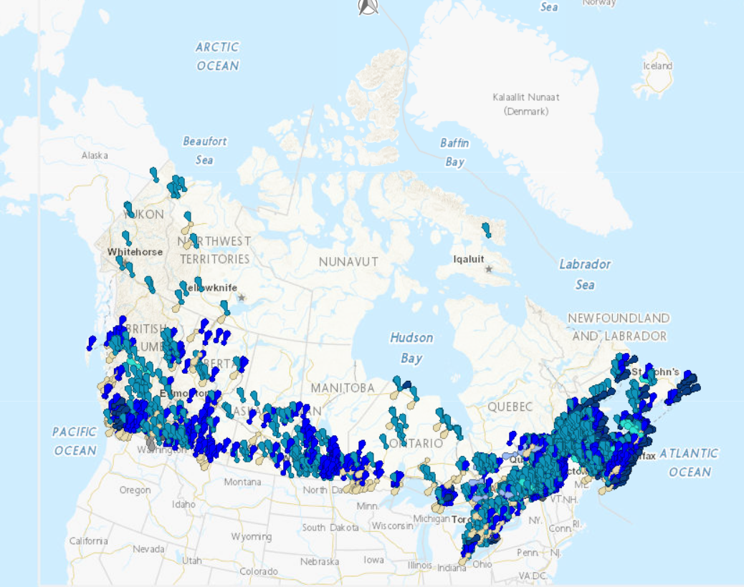
Objective
Compute flood drivers (causes)
For watersheds we have data for
Predict likely flood drivers
For watersheds we don’t have data for
Potential categories/classes may include:
Spring freshet-fluvial,
Summer flash-pluvial,
Ice jam/frazil
…
or possibly: surge-dominant, discharge-dominant, compound-dominant or insignificant

Slide 3
Why?
Size/Shape
Large to Small area
Drainage Density
Dense High density (well-drained) to Sparse Low Density (poorly drained
Flood mechanisms
Drivers of flooding (e.g.: freshet, heavy rain, ice jam, etc)
Overall Class Category
Relief
High to Low relief
Circular to Elongated
to support Watershed Classification project
Watershed Classification: unsupervised problem
based on: Hydro geomorphological characteristics, climate data, flood history
Output:
table of characteristics based on flood drivers, geometry, terrain, etc. within the watershed

Slide 4
Potential Benefits
Prediction in Ungauged Basins:
Classifying watersheds can enable the development of predictions in ungauged basins
Adapting to Climate Change:
In regions facing strong pressures from climate change and land use, historical streamflow records may not reflect current behavior, necessitating new approaches to watershed classification.
Impact Assessment:
Understanding how changes in key traits such as climate and land management may affect watershed function - essential for sustainable development and ecosystem preservation.
AI modellers
Model Performance and Transferability
Can be used to understand the applicability of model transference between watersheds (and a proxy estimating accuracy of results in transferred basins)
Descriptive attributes for end users of CHN
Thematic maps

Slide 5
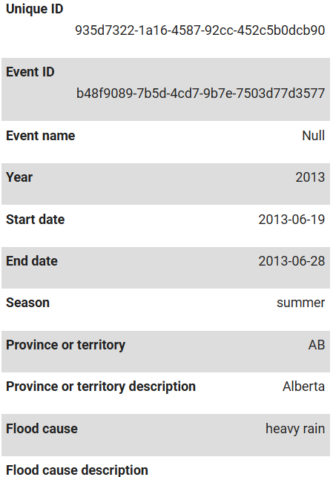
Data
Historic Flood Events database
Representation of the causes of flooding events in the form of multiple points.
The point groupings correspond to the set of locations that were affected by the same event.
The inventory of past flooding events was compiled from various public sources and standardized into a common data model.
Sources used are included in the data.
Event locations have been extensively revised to have one location per location reported as affected by the flood.
Flood events for which no location was included in the sources used are positioned on the place name of the location affected by the flood. The event positions do not indicate where the flooding occurred.
Flood events that affected more than one locality are represented by a multipoint.
Sample of attributes

Slide 6
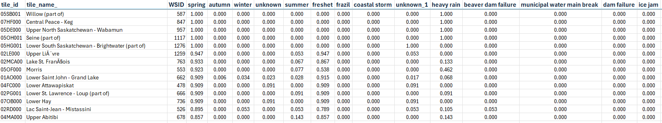
Example Extract from HFE:
Zonal statistics: count number of events in watershed, distribute to ‘Time of Year’ and ‘Flood Cause/Flood Driver’
Can have Multiple times (season) of Year and different causes in a single watershed
---------Seasons----------
--------------------------Flood Drivers / Causes----------------------------

Slide 7
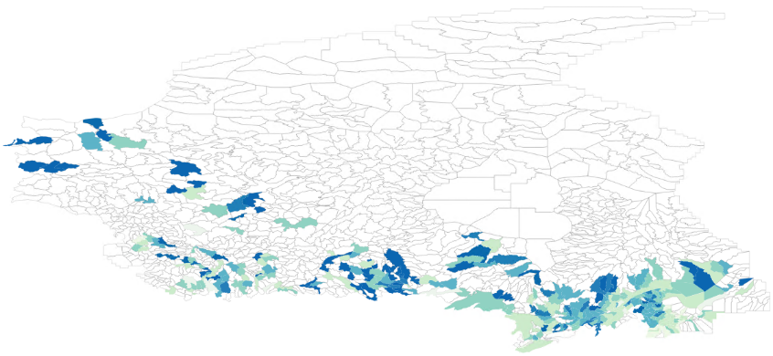
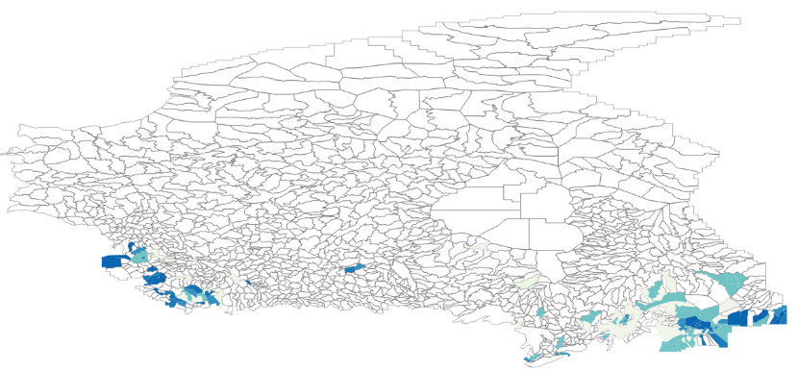
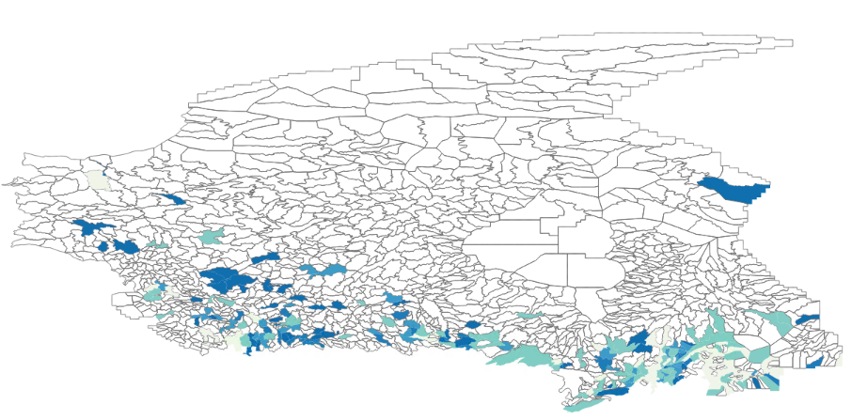
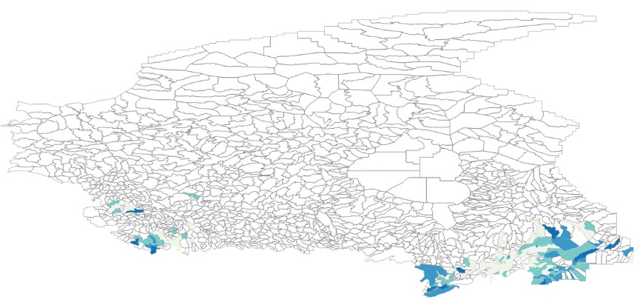
Percentage of records from HFE : per season
Spring:
Summer:
0.01-20%
20-40%
40-60%
60-80%
80-100%
Autumn:
Winter:

Slide 8
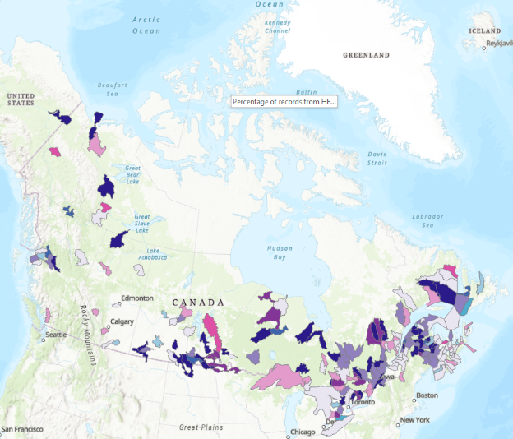
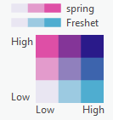
Preliminary Exploration/Tests: of the HFE data: bivariate maps *quickly made – and not QC d yet
Spring floods and freshet

Slide 9
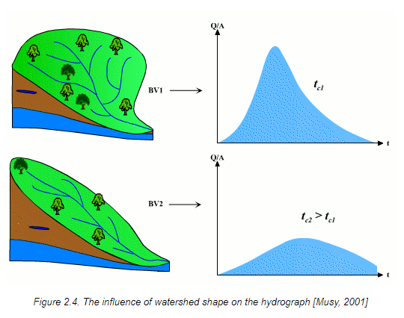
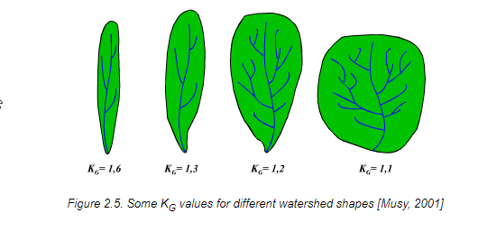
Data
Labels from HFE
Auxilliary data from Watershed analysis and extraction:
Terrain, Shape, Size, Land Use, Hydrography

Slide 10
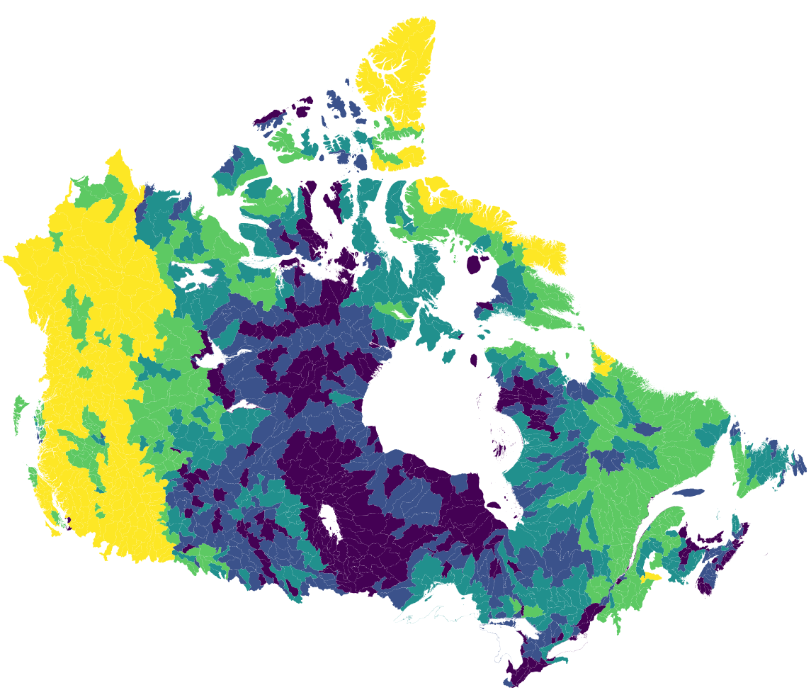
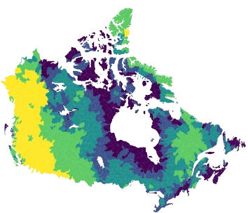
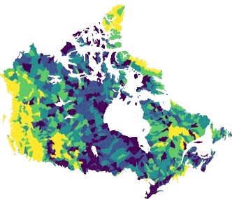
Terrain
Elevation Range
Characteristics which describe the terrain in the watershed.
These can influence direction of flow of water accumulation of flow of water, describe min, max and range of elevations, and distribution of terrain in a given watershed
Mean Elevation
Relief Ratio

Slide 11
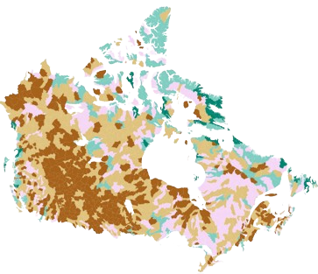
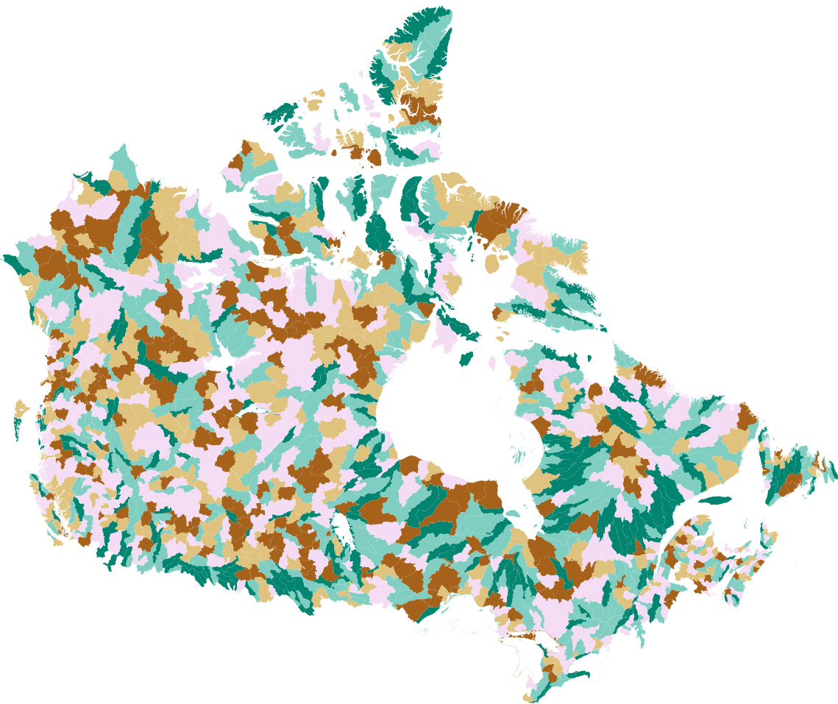
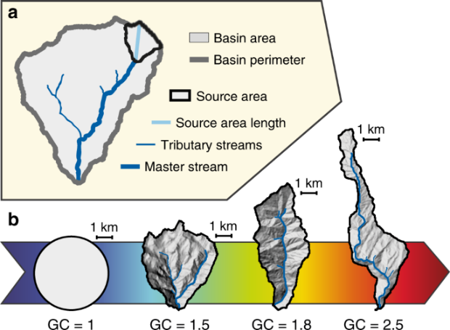
Geometry
Gravelius Shape Index
Size and Shape
With respect to hydrography, these can influence the time in takes for water to reach the outlet (and the shape of the hydrograph) and information on the narrowness or elongation of a watershed
Elongation Ratio

Slide 12
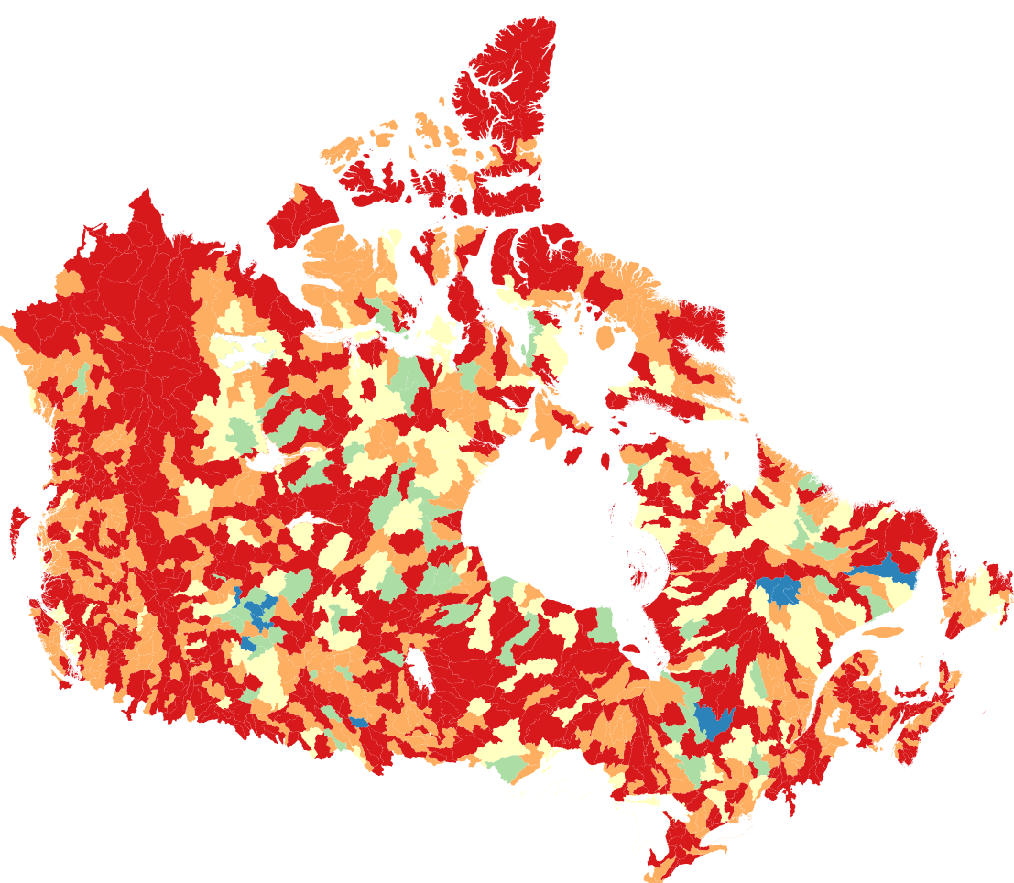
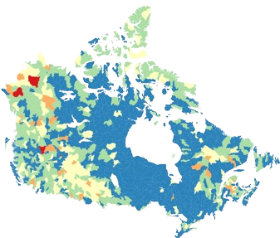
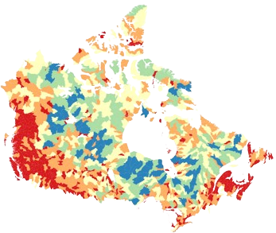
Hydrography
Bifurcation Ratio
Measures of the density of the river networks
Drainage Density
Longest River

Slide 13
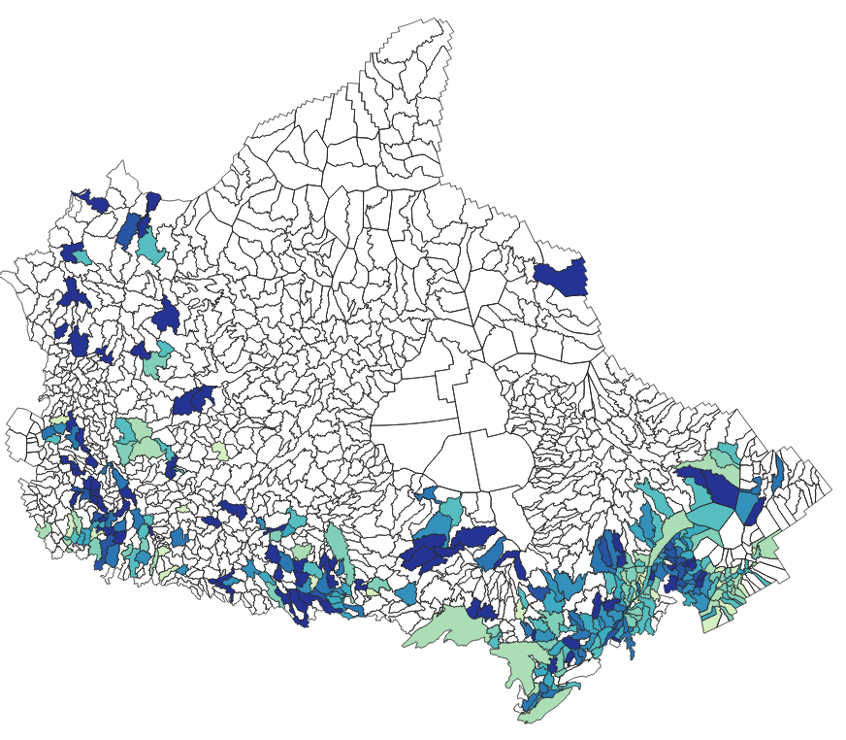
Input ---------------------- > Predict
Watersheds with
Freshet as a
primary flood
driver

